Slide 1
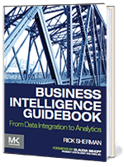
Slides for Courses Using the Business Intelligence Guidebook
From Data Integration to Analytics
by
Rick Sherman
www.biguidebook.com

Slide 2
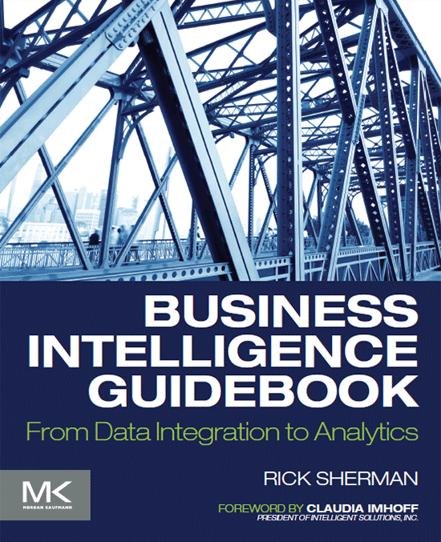
Business Intelligence Guidebook – From Data Integration to Analytics
www.biguidebook.com
November 2014
Imprint: Morgan Kaufmann
Print Book ISBN : 9780124114616
eBook ISBN : 9780124115286

Slide 3
Chapter 2 Justifying BI: Building the Business and Technical Case
Topics in this chapter:
- Building the business case.
- Building the technical case.

Slide 4
Why Justification is Needed?
You have recognized and understood the importance of Business Intelligence (BI) and analytics across industries, the IT group are aligned on benefits, and the business executives also understand that BI will provide the edge that they need to be competitive or to grow their business. Everyone agrees.
So it seems like a no-brainer to skip the justification process and proceed directly into the project, right? Not so fast.

Slide 5
Why Justification is Needed? (Cont.)
Although enthusiastic business executives or chief information officers (CIOs) can make it possible to get BI projects approved without much formal justification effort, it is not a good idea.
Project approval is not the only reason to go through this process. A careful, well-documented justification can help prevent your project from being labeled a failure.
According to studies, the majority of BI projects fail.
These projects fail not because of technology shortcomings but from an expectations shortfall.
In addition, BI projects have a tendency to be late and over budget.
Many of these problems stem from failing to establish what needs to be built from a business perspective, and then managing the project’s scope and change management based on these flawed expectations.

Slide 6
Why Justification is Needed? (Cont.)
Therefore, the BI team needs to make both the business and technical case to:
determine the need,
identify the benefits, and,
most importantly, set expectations.
With the case established, the BI team needs to estimate scope, costs, schedule, and a return on investment (ROI).
Identifying risks and an organization’s readiness is critical to determining how realistic expectations are.
In brief, although a BI justification is generally regarded only as a selling device, its importance as a vehicle to set expectations and guide the BI project cannot be overlooked.

Slide 7
Building the Business Case
BI projects can get approved without a business case when the business sponsors or CIOs think it is obvious that a BI investment will pay off.
But even if a BI effort can get approval and funding without justification, it is crucial to build a business case and get stakeholders to agree on it.
There are many hidden dangers of skipping the process of developing a business case. During the first generation of data warehousing, many BI groups made this mistake when they fell into the trap of assuming it was obvious that a data warehouse (DW) was needed.
Typically, the “if we build it they will come” approach resulted in: projects that were too big and long, missed expectations, and spawned alternate reporting solutions such as spreadmarts or data shadow systems.

Slide 8
Building the Business Case (Cont.)
The business case needs to answer the following in respect to the BI solution:
What business problems or opportunities are being addressed?
Who will use it?
What are the anticipated business benefits?
Were there any prior BI initiatives that failed, and if so, why?
After answering these questions, the BI team needs to get business sponsorship, involvement, and commitment to the BI effort.

Slide 9
Building the Business Case (Cont.)
Defining the business case:
To answer these questions and define the business case, you will need to:
Review the organization’s business initiatives and processes
Enlist a BI sponsor
Connect with BI stakeholders
Identify business processes affected by BI
Document business benefits
The BI efforts should be based on supporting the needs of business initiatives, business drivers, and business processes.
The focus is on solving business problems, not IT issues such as what BI tool should be used.
By putting the business first, you encourage the business to value and use the resulting BI solution.

Slide 10
1. Review Organization’s Business Initiatives and Processes
The success of BI lies in addressing the organization’s key business needs and priorities.
The best way to understand these needs is to learn what your organization faces in terms of:
Strategic business initiatives and their underlying data needs
Current business processes being hindered by analytical bottlenecks

Slide 11
1. Review Organization’s Business Initiatives and Processes (Cont.)
Business Initiatives
Most organizations perform business planning for strategic initiatives with a minimum time horizon of the next couple of fiscal years.
These business initiatives have been prioritized, approved, funded, and scheduled.
In today’s data-driven climate, it is almost a certainty that these initiatives need data and analytics.
The BI team needs to do their due diligence and determine how BI would support these business initiatives. They can then use this information to help build a business case.

Slide 12
1. Review Organization’s Business Initiatives and Processes (Cont.)
Business Processes
When business processes are constrained by limitations in the data and its analysis (e.g. an inability to analyse customer’s sales across all channels with the profit margin of the products purchased keeps the business from determining the life-time value of that customer).
It may not be readily apparent to the business that analytics has become a gating factor in these business processes.
Adding the current analytical bottlenecks along with the business initiatives needing analytics can help strengthen the business case.

Slide 13
1. Review Organization’s Business Initiatives and Processes (Cont.)
Be aware, however, that listing the business initiatives and bottlenecked processes may generate an overwhelming business demand for BI that an organization will not be able to deliver all at once.
This list should be the foundation for a long-term BI program with priorities matched to business demand.
In the short term, prioritize the list and reduce it to a set of business requirements that this BI justification will address.

Slide 14
2. Solicit BI Sponsorship
After Identifying the business needs, the next step is to solicit and engage business sponsors.
Use your list of business needs (above) to identify the business people you will approach as potential business sponsors.
The sponsor needs to:
Either have the budgetary authority to fund the BI project or be an influential leader who can get funding approved.
Beyond the initial funding, a business sponsor needs to secure the commitment of resources from the business stakeholders and users (below) to ensure BI success.
Key characteristics of a business sponsor are: being politically astute, enthusiastic, and realistic.
The first two characteristics are obvious, but it is important that neither the sponsor nor the BI team become overly optimistic (Avoid over-optimism to ensure realistic expectations for BI success).
In addition, a realistic sponsor will understand that there may be problems or setbacks during the BI project that will need to be handled. Getting support for the typical issues that one always encounters during a BI project will be extremely helpful.

Slide 15
2. Solicit BI Sponsorship (Cont.)
Ideally, a BI project has the support of the CIO, but that person should not be the sole sponsor of the project. The risks of a CIO-only sponsored BI project can include that it:
Is perceived as technology driven
Does not get business commitment and involvement
Has an unlimited scope and is difficult to manage
The BI project needs at least one committed business sponsor and, if possible, multiple business sponsors representing a cross-section of the organization.
This is a balancing act, where one sponsor may create the impression that the BI effort is geared exclusively to that sponsor’s business group, or too many sponsors create friction with conflicting priorities. The best case is one primary sponsor with a couple of secondary sponsors.
The BI team needs to interview business sponsors to determine the business initiative and current analytical pain points that they would like to address, set priorities, and help establish the scope of the BI project (see Chapter 3: Defining Requirements—Business, Data and Quality).

Slide 16
3. Enlist BI Stakeholders
With the business sponsors engaged and their priorities established, the next step is to enlist the business stakeholders who will be affected by the BI project.
They include the business people who will be either direct users of the BI solution or whose work will be affected by the BI solution, as well as those working on data governance.
Getting the business stakeholders involved while building the business case:
Enables more detailed business input and may help identify gaps and risks.
In addition, the stakeholders will likely be the primary input for detailed business requirements later in the project (Chapter 3)

Slide 17
3. Enlist BI Stakeholders (Cont.)
One of the most frequent mistakes made when engaging business stakeholders is relying exclusively on a business group’s “power users”.
The power users typically use spreadsheets or build spreadmarts to provide reporting to their organization.
If you limit yourself to them then you may encounter several problems:
You never know what other stakeholders really need to do their jobs since you just may be hearing filtered requirements from the power users.
Business power users, being data and tool savvy, are not necessarily representative of the other stakeholders’ abilities and needs.
Power users built the spreadmarts, and, sometimes very subtlety, they become obstacles to replacing those spreadmarts with the BI solution.

Slide 18
4. Identify Business Processes Affected by BI
Business processes are tasks performed by an organization, including order processing, customer acquisition, budgeting, and marketing campaigns.
These processes generate data that needs to be captured, monitored, and measured.
Business processes generate the business measures and key performance indicators (KPIs) that are so common in BI deliverables.

Slide 19
4. Identify Business Processes Affected by BI (Cont.)
Organizing your business case, and later your project deliverables, around business processes offers many advantages:
It helps identify BI users and how they will use the solution in their jobs.
Business-focused approach leads to more compelling business cases and increased stakeholder involvement.
Focusing on business processes facilitates the identification of business benefits resulting from BI implementation.

Slide 20
5. Document Business Benefits
You need to formalize the business case for BI projects, otherwise, several problems can arise:
Overblown expectations, which cannot be met
Underfunding for BI initiative and the ongoing BI team
Continued use or expansion of data shadow systems
Inability to gather business support for data governance initiatives
BI is seen as expensive overhead and not an enabler supporting business
BI is viewed as a mere report generator

Slide 21
5. Document Business Benefits (Cont.) Determine Business Value (Tangible Benefits)
Relying solely on intangible benefits:
An organization should not proceed with a business case based solely on intangible benefits such as providing “a single version of the truth” or “better decision making.”
Although the BI solution likely will deliver these benefits, they are highly subjective and difficult to substantiate.
This makes them more than likely a recipe to disappoint business stakeholders who expected something else or something more.
Instead, base the business case on tangible or quantifiable business benefits. Tangible benefits for BI typically fall into several broad categories (Figure 2.1.)

Slide 22
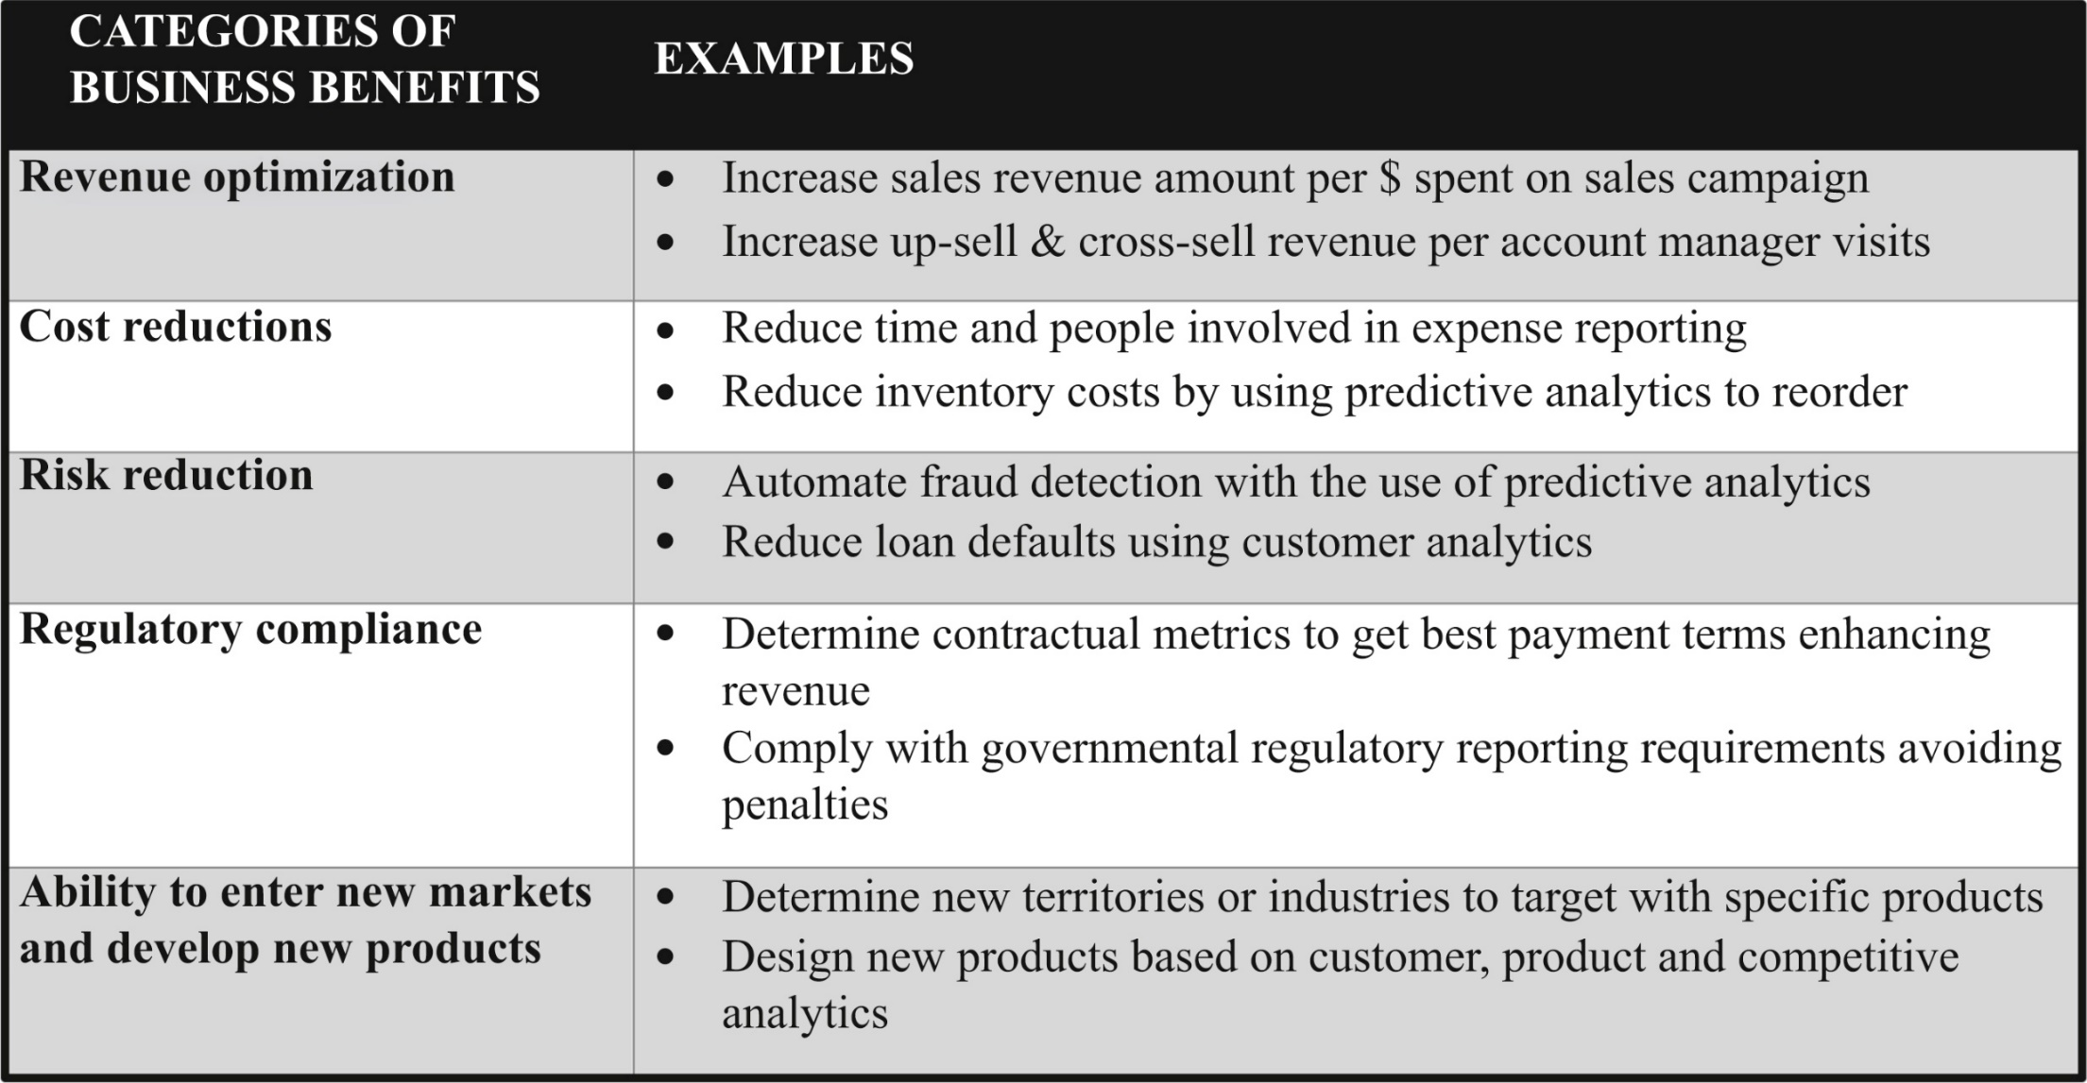
Business benefits matrix
f02-01

Slide 23
5. Document Business Benefits (Cont.) Determine Business Value (Tangible Benefits)
One of the benefits of aligning the BI business case with business initiatives is that the initiatives have likely already been justified and have tangible benefits assigned to them. If BI becomes an essential component of those initiatives, then the work of assigning tangible benefits has already been done for you.
There will also be tangible benefits associated with the business processes that the BI solution is going to affect—you’ve already identified these processes in the business case. Have a discussion with the business stakeholders to determine exactly what tangible benefits are associated with those processes.

Slide 24
5. Document Business Benefits (Cont.) Determine Business Value (Tangible Benefits)
Gather business value resulting from BI projects from articles and case studies
Analytics and data-driven decision making are invaluable to organizations across all industries.
Numerous articles and case studies demonstrate the business value resulting from BI projects.
Gathering a list of business benefits from BI projects should not be difficult, given the widespread recognition of their importance.

Slide 25
Building The Technical Case for BI Projects
A BI project will introduce new technologies and products into an enterprise across a variety of BI, data integration, database, and infrastructure categories.
The steps toward building your technical case are:
Selecting the products and technologies, or at least narrowing down a short list.
Convincing business people and technologists that they ought to use these tools.

Slide 26
1. Technology and Product Short Lists
With each new technology and product, the best practice is to conduct an evaluation and, if possible, a proof of concept.
The evaluation should have stakeholders, both technologists and business people, involved throughout the process.
It is important to involve the people who are going to use these technologies in their day-to-day jobs, whether it is the business person who will perform analysis or the developer who will use the tools to create the BI environment.
Involve the management personnel, business power users, and architects (if you have them). Be very cautious, however, if they are the only people involved, because their ability to learn new tools may be far better than that of the people who will really use the tools. BI projects can flounder because business people cannot get used to the Interface and capabilities of a new tool.

Slide 27
1. Technology and Product Short Lists (Cont.)
The product evaluation process will involve the following steps (Figure 2.2)
Gather and prioritize requirements
Establish success and value criteria
Select short list of product candidates
Conduct product reviews with hands-on proofs of concept, if possible
Score and rank products
Review results and select product(s)
Haggle with product vendors over pricing.

Slide 28
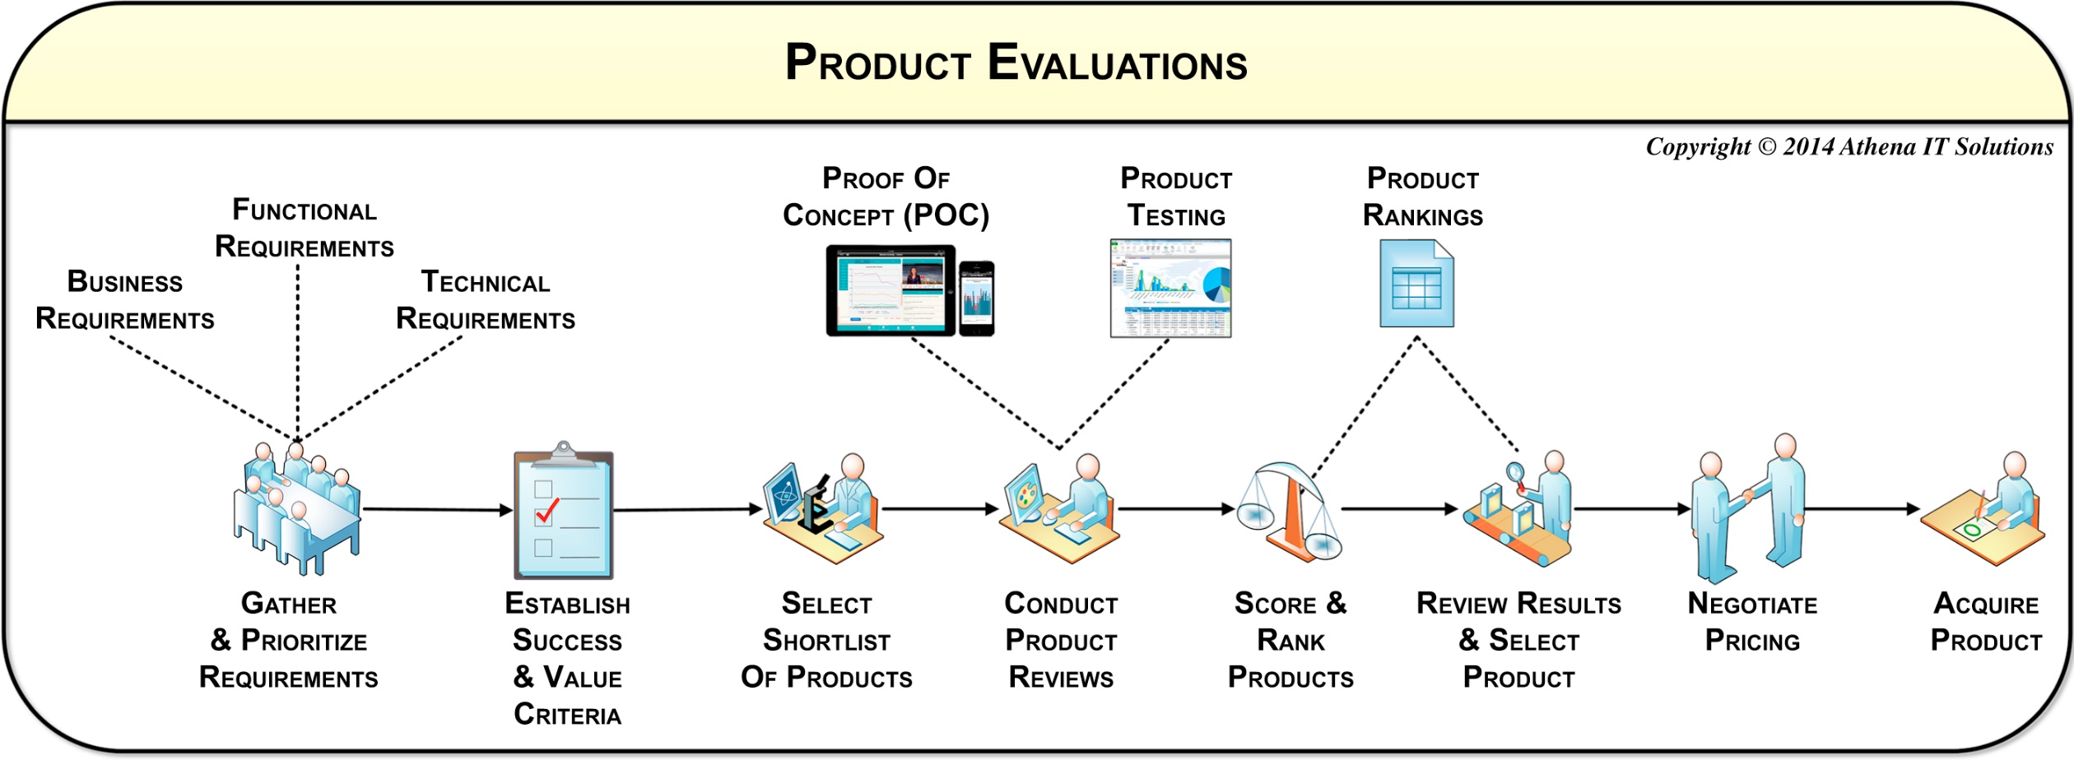
Selecting product short-list(s) workflow
f02-02

Slide 29
1. Technology and Product Short Lists (Cont.)
Product Evaluation Considerations
Consider the costs of the technologies, ranging from free (at least in respect to licensing costs) to very expensive.
Prior to creating your product short list, you need to get a ballpark estimate on what your organization would likely spend and what the products will cost.
Filter products based on budget and affordability. It does not make sense to evaluate products that you will not realistically purchase unless it is part of your bargaining strategy with the vendor.
Conduct evaluations to determine the best solution objectively.
Most evaluations have a long list of functional and usability criteria from both technology and business perspectives.
After the product reviews, score each product according to this criterion and then rank them, creating a final score that identifies the winner. An objective evaluation will help lead to the best solution for the organization.

Slide 30
1. Technology and Product Short Lists (Cont.)
Product Evaluation Considerations
Decide when to conduct evaluations based on organizational needs and project timelines.
There are two mind-sets regarding when product evaluations will occur (See Chapter 18.):
Some organizations will conduct the evaluations during the BI justification phase in order to determine the specific products and their costs. In this scenario, the organization knows it needs a BI project, but more details are necessary for specific projects to be approved.
The other approach, which is more common, is to perform an abbreviated evaluation that would document:
List of technologies needed
Short list of products that will evaluated
Range of high-level cost estimates for above

Slide 31
2. Convincing Business People
Business excitement for BI may diminish when considering time, costs, and resources.
Business users may opt for "good enough" alternatives due to lower investment and quicker implementation.
An alternative to using new technology can even mean doing nothing (continue to use what you have) or use substitutes.
These substitutes can include expanding operational reporting or using more data shadow systems.
These “good enough” alternatives may mean that the business does not fully engage during the BI project or that they use the alternative solution more than BI solution once it is operational.

Slide 32
2. Convincing Business People (Cont.)
BI team must justify why BI solution is superior, focusing on functional, productivity, and long-term cost perspectives.
This is not a feature comparison like the tool evaluation but rather a comparison of alternatives.

Slide 33
2. Convincing Business People (Cont.)
Operational systems offer short-term benefits but may lack long-term scalability and agility.
Operational systems are typically bundled with reporting capabilities. Business people may complain about these systems, but the short-term benefit is that they are inexpensive and may be producing some value.
If the business choses the alternative of expanding these reporting capabilities, it will likely be cheaper and faster than a BI solution, at least initially.
Likewise, it is almost guaranteed that business people have been using spreadsheets to do reporting and, if the reporting complexity warranted it, they also built data shadows systems.
However, cheaper and faster stops looking so attractive when you look at the medium term, which is more expensive for IT support, and the long term, which is far more expensive and less agile as you attempt to expand with all those data shadow systems.

Slide 34
2. Convincing Business People (Cont.)
The technical case, therefore, does not end with comparing different BI tools and selecting the “best,” but rather needs to compare BI tools with alternatives that business people are inclined to use.
This comparison is not a feature checklist bake-off; it is a reality check of what would convince business people to actually use the BI tool.
The BI evaluation can give a false impression that just because a tool has many features it will be preferable to what the business users have available now.
It is not the best tool if the business people will not use it.
Prioritize business value over feature count!

Slide 35
2. Convincing Business People (Cont.)
Importance of the time to learn and adapt business processes
The business community has to invest time in learning the new BI tools and changing existing business processes to take advantage of them.
They also have to spend time waiting for the new BI solution to be built while the business climate—sales, operations, competitors, the economy, and government regulations—keeps changing.
That time is an opportunity loss that must be factored into the cost–benefit calculations.
In fact, the first generation of DWs often failed for the very reason that they took too long to build and the businesses could not wait.

Slide 36
3. Convincing the Technologists
Technologists may express excitement about BI project but may resist change underneath.
Technologists may be hesitant due to fear of losing expertise and becoming novices again.
Lack of training in BI concepts and architectures may hinder adoption of new tools.
Involvement in technology and product selection crucial.
Determine required technologies (business intelligence, data integration, database, and infrastructure tools) and create short list of product candidates.

Slide 37
3. Convincing the Technologists (Cont.)
Sell technologists on benefits of new products for both the business and themselves.
As discussed earlier, it is most helpful to have a powerful sponsor who can guarantee that people will commit their time and will have enough of their other tasks freed up for them to work on this project.
You need to use care in selecting and using these new tools, and try to help the technologists become even more valuable in their current organization and in their industry.
Learning new skills and then becoming an expert in that tool does make them more marketable.
You need them to not only help in the selection but advocate their use.

